Slide 1
Sorting and searching

Slide 2
Searching
The basic characteristics of any searching algorithm is that
searching should be efficient,
it should have less number of computations involved into it,
as well as the space occupied by such a technique should be less.
Various searching techniques are:
Linear search
Binary search

Slide 3
Linear Search / Sequential Search
It is a method for finding a particular value in a list that checks each element in sequence until the desired element is found or the list is exhausted.
The list need not be ordered.
Linear search is usually very simple to implement, and is practical when the list has only a few elements, or when performing a single search in an unordered list.
If the search element is not in the array, then it scans the entire array, so takes time as per the number of elements in the array i.e. n.

Slide 4
Algorithm of Linear Search
BEGIN
Get input A[n] and X (element to be searched)
i ← 0
Repeat through step 6 for i < n
If A[i] == X
Print “Match found at array index i”
Exit
i ← i + 1
Print “Match not found”
8. END

Slide 5
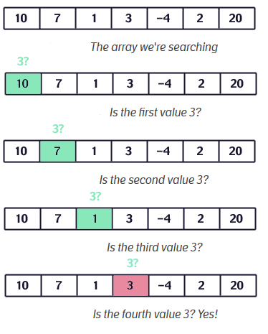
Linear Search / Sequential Search

Slide 6
Binary Search
Procedure binary_search
A ← sorted array
n ← size of array
x ← value to be searched
Set lowerBound = 1
Set upperBound = n
while x not found
if upperBound < lowerBound
EXIT: x does not exists.

Slide 7
Contd…
set midPoint = lowerBound + ( upperBound - lowerBound ) / 2
if A[midPoint] < x
set lowerBound = midPoint + 1
if A[midPoint] > x
set upperBound = midPoint - 1
if A[midPoint] = x
EXIT: x found at location midPoint
end while
end procedure

Slide 8
Sorting
Sorting means arranging the elements of an array so that they are placed in some relevant order which may be either ascending or descending.
That is, if A is an array, then the elements of A are arranged in a sorted order (ascending order) in such a way that A[0] < A[1] < A[2] < … < A[N].
The practical considerations for different sorting techniques would be:
Number of sort key comparisons that will be performed.
Number of times the records in the list will be moved.
Best, average and worst case performance.
Stability of the sorting algorithm where stability means that equivalent elements or records retain their relative positions even after sorting is done.

Slide 9
Bubble Sort
Algorithm
begin BubbleSort(list)
for all elements of list
if list[i] > list[i+1]
swap(list[i], list[i+1])
end if
end for
return list
end BubbleSort
Notes:
Repeatedly sort two adjacent elements if they are in wrong order

Slide 10
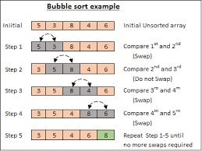

Slide 11
Selection Sort
The algorithm divides the input list into two parts:
the sublist of items already sorted, which is built up from left to right at the front (left) of the list,
and the sublist of items remaining to be sorted that occupy the rest of the list.
Initially, the sorted sublist is empty and the unsorted sublist is the entire input list.
The algorithm proceeds by finding the smallest (or largest, depending on sorting order) element in the unsorted sublist, exchanging it with the leftmost unsorted element (putting it in sorted order), and moving the sublist boundaries one element to the right.
Notes:
Find the minimum element in unsorted array and swap it with element at beginning.

Slide 12
Selection Sort
Technique:
Consider an array ARR with N elements. The selection sort takes N-1 passes to sort the entire array and works as follows. First find the smallest value in the array and place it in the first position. Then find the second smallest value in the array and place it in the second position. Repeat this procedure until the entire array is sorted. Therefore,
In Pass 1, find the position POS of the smallest value in the array and then swap ARR[POS] and ARR[0]. Thus, ARR[0] is sorted.
In Pass 2, find the position POS of the smallest value in sub-array of N-1 elements. Swap ARR[POS] with ARR[1]. Now, A[0] and A[1] is sorted
In Pass 3, find the position POS of the smallest value in sub-array of N-2 elements. Swap ARR[POS] with ARR[2]. Now, ARR[0], ARR[1] and ARR[2] is sorted.
In Pass N-1, find the position POS of the smaller of the elements ARR[N-2] and ARR[N-1]. Swap ARR[POS] and ARR[N-2] so that ARR[0], ARR[1], … , ARR[N-1] is sorted.

Slide 13
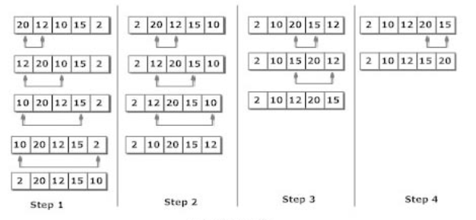
Selection Sort

Slide 14
Algorithm of Selection Sort
BEGIN
Get input A[n]
Repeat through step 4 for i = 1 to n-1
Repeat for j = i + 1, … , n
If A[j] < A[i]
temp = A[i]
A[i] = A[min_index]
A[min_index] = temp
END
6. END

Slide 15
Thank you
ANY QUESTIONS???
Notes:
Insertion sort- insert the element of unsorted array to its correct position in the sorted array

